Slide 1
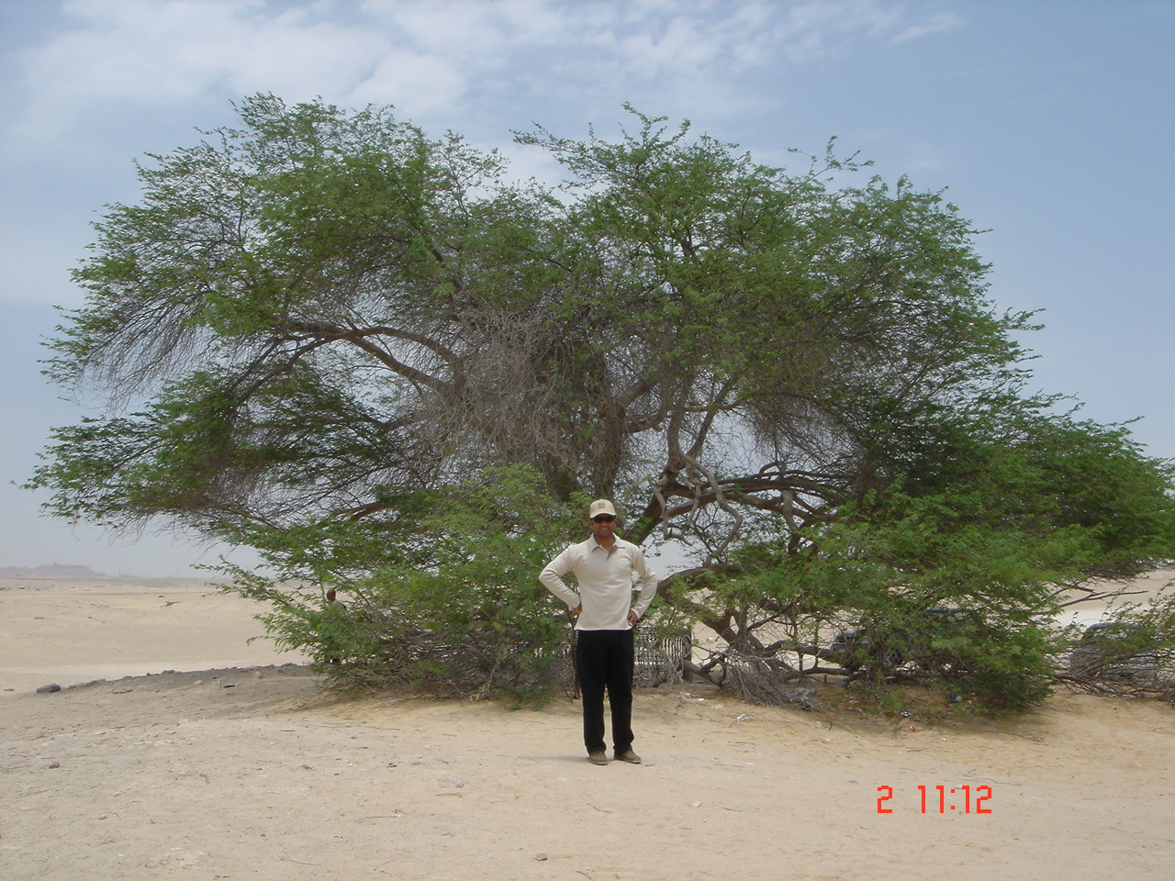
Branching and Merging Guide – Visuals v3

Slide 2

VISUAL STUDIO 2012 READINESS Branching and Merging - Template
Notes
We use a  to indicate a change, which is either B, BM, FI, RI, CO, or CI for Branch, Baseless Merge, Forward Integration, or Reverse Integration for VC operations.
Workspace operations are indicated by grey  and lines, using CO, CI and GL for Checkout, Checkin and Get Latest workspace operations.
We use colours only to highlight concepts where the classic blue (RGB 0 113 188) diagram does not work.
Baseless Merges are shown with dotted merge lines.
Align ’s vertically and horizontally.
Bubbles are .25”x.25”
Action line and outline width is 1pt
Branch line is 2pt
Font in bubbles is Segoe UI Light 10 auto scale to shape
 indicates read-only
✗ indicates deleted branch
disruptive feature
BM
dev
label
RI
main
B
FI
RI
RGB 0 113 188

Slide 3
VISUAL STUDIO READINESS Main Only
main
V1.0
V1.1
V2.0

Slide 4
VISUAL STUDIO READINESS Release Isolation
main
Start v2
B
B
Emergency Hotfix
[]
RI
release v1
release v2

Slide 5
VISUAL STUDIO READINESS Development Isolation
dev
RI
RI
main
B
FI
FI
FI

Slide 6
VISUAL STUDIO READINESS Development and Release Isolation
dev
RI
RI
main
B
FI
B
FI
B
FI
Emergency Hotfix
[]
RI
release v1
release v2

Slide 7
VISUAL STUDIO READINESS Servicing and Release Isolation
main
B
B
servicing r1.sp1
servicing r2.sp1
B
RI
B
release 1
release r2
[]
RI
Emergency Hotfix

Slide 8
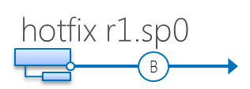
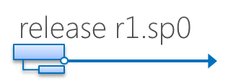
VISUAL STUDIO READINESS Servicing, Hotfix and Release Isolation
main
B
servicing
B
B
RI
hotfix r1.sp1
Emergency Hotfix
✗
B
RI
Delete old hotfixes
✗
[]
Delete old releases
release r1.sp1

Slide 9
VISUAL STUDIO READINESS Feature Isolation
feature …n
RI
✗
feature 1
RI
✗
main
B
FI
FI

Slide 10
VISUAL STUDIO READINESS Code Promotion
V1.0
V1.1
V1.2
V1.3
main
B
test
B
RI
V1.1
release
V1.1

Slide 11
VISUAL STUDIO READINESS Continuous delivery
feature …n
RI
✗
features are included but hidden until enabled
main
enabled feature set
build feature 3
build feature 2
feature 1
build feature 1
Feature 1 Enabled
Feature 2 Enabled
Feature 3 Enabled
Feature 1 Disabled
RI
✗
small scope
main
B
FI
FI
features are included but hidden until enabled
short lifespan
main
enabled feature set
build feature 3
build feature 2
build feature 1
B
B
Feature 1 Enabled
Feature 2 Enabled
Feature 3 Enabled
Feature 1 Disabled
[]
release v2
[]
release v1

Slide 12
VISUAL STUDIO READINESS Release Isolation
C
C
RI
BM
B
B
RI
FI
A
A
B
FI

Slide 13

VISUAL STUDIO READINESS Release Isolation
dev
V2.DEV
RI
V1.0
V1.1
V1.1 Hotfix
V2
V3
main
B
FI
B
B
v3
[]
[]
v2

Slide 14
VISUAL STUDIO READINESS Release Isolation
dev
V2.DEV
RI
V1.0
V1.1
V1.1 Hotfix
V2
V3
main
B
FI
B
B
v3
[]
v2

Slide 15
VISUAL STUDIO READINESS Release Isolation
dev
V2.DEV
RI
V1.0
V1.1
V1.1 Hotfix
V2
V3
main
B
FI
B
B
B
v3 servicing
v3 release
[]
v2

Slide 16
VISUAL STUDIO READINESS HOL Development Isolation
dev
V2.DEV
V1.0
V1.1
V1.1 Hotfix
main
B
dev
V2.DEV
V1.0
V1.1
V1.1 Hotfix
main
B
FI
dev
V2.DEV
RI
V1.0
V1.1
V1.1 Hotfix
main
B
FI

Slide 17
VISUAL STUDIO READINESS HOL Hybrid Development & Feature Isolation
featurePOWER
RI
✗
featureMOD
RI
dev
RI
main
B
B
FI
FI
FI

Slide 18
VISUAL STUDIO READINESS HOL Hybrid Development & Feature Isolation
featurePOWER
RI
featureMOD
RI
dev
main
B
B
FI
FI

Slide 19
VISUAL STUDIO READINESS HOL Hybrid Development & Feature Isolation
featurePOWER
RI
✗
featureMOD
RI
✗
dev
B
FI
FI
RI
main
B
FI

Slide 20
VISUAL STUDIO READINESS Baseless Merge
dev ft3
v1.1 ft3 start
v1.1 ft3
RI
dev ft2
v1.1 ft2 start
v1.1 ft2
BM
RI
dev ft1
v1.1 ft1 start
v1.1 ft1
RI
main
v1.1 ft1
v1.1 golden
B
B
FI
FI
FI
FI
FI
release
v1.1
[]
RI
v1.0 hotfix
v1.1 release

Slide 21
VISUAL STUDIO READINESS Create a new source control branch option - problematic
$/Project1
main
B
B
Release 1.0.1
❷ Using the “Create a new source control branch option” ensures that the new TeamProject2 contains all data contained in source control folder of TeamProject 1.
Release 1.1.2
$/Project2
❶ Select “Create a new source control branch option” when creating Team Project
main
B
B
Release 1.0.1
Release 1.1.2

Slide 22
VISUAL STUDIO READINESS Create a new source control branch option – alternative - problematic
$/Project1
main
B
B
B
Release 1.0.1
❷ Branch off specific folder in the existing project rather than from the root.
Release 1.1.2
$/Project2
❶ Select “Create an empty source control folder” when creating Team Project
main

Slide 23
VISUAL STUDIO READINESS Release Branching – Advanced Simplified
dev
main
B
B
servicing
B
hotfix
B
release


Slide 24
VISUAL STUDIO READINESS Release Branching – Advanced Simplified
dev
main
B
B
servicing
B
hotfix
B
release


Slide 25

VISUAL STUDIO READINESS Feature Parent with two children - Checkout
C:\2\feature
C:\1\feature
main
CO
CO

Slide 26
VISUAL STUDIO READINESS Feature Parent with two children – Get Latest Child 1
C:\2\feature
C:\1\feature
main
CO
CO
GL

Slide 27
VISUAL STUDIO READINESS Feature Parent with two children – Checkin from Child 1
C:\2\feature
C:\1\feature
CI
main
CO
CO
GL

Slide 28
VISUAL STUDIO READINESS Feature Parent with two children - Get Latest Child 2
C:\2\feature
C:\1\feature
CI
main
CO
CO
GL
GL

Slide 29
VISUAL STUDIO READINESS Feature Parent with two children - Checkin from Child 2
C:\2\feature
CI
C:\1\feature
CI
main
CO
CO
GL
GL

Slide 30
VISUAL STUDIO READINESS Feature Parent with two children and integration branch
C:\2\feature
CI
C:\1\feature
CI
integration
CO
CO
GL
GL
RI
main
B
FI

Slide 31
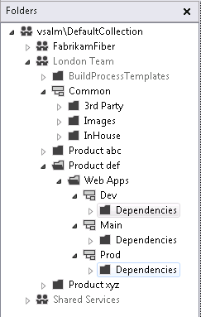
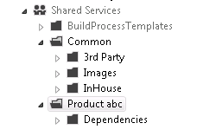
VISUAL STUDIO READINESS Sharing Resources Diagrams
B
MAPPING
RI

Slide 32
VISUAL STUDIO 2READINESS Branching and Merging - Rational ClearCase
main/A
main/B
main/s/B
0
0
1
1
0
*1
*3
2
V1.0
2
*2
3
4
V2.0
Rule: element * V2.0
main/x sub-branch
5
main branch
Name in VOB → A@@/main/x/y/1

Slide 33
VISUAL STUDIO READINESS Branching is “easy”
branch 3
RI
branch 2
RI
branch 1
RI
main
B
“easy”
“area of pain”

Slide 34
VISUAL STUDIO READINESS Branch Post 1
testing
Share release with users
3
main
release
bug reported
☺
☹
merge how with what?
5
CI
CI
CI
workspace
6
4
bug fix
?
1
2
no branch
changeset
check-ins
fix bug

Slide 35
VISUAL STUDIO READINESS Branch Post 2
testing
Share release with users
3
5
release
release
bug reported
bug fix
RI
fix bug
6
main
4
☺
CI
FI
☹
CI
CI
CI
1
2
no branch
changeset
check-ins

Slide 36
VISUAL STUDIO READINESS Branching is “easy”
branch 3
RI
branch 2
V0.2
RI
branch 1
V0.1
RI
v0
main
B
Same feature re=-created … we should develop once and share!

Slide 37
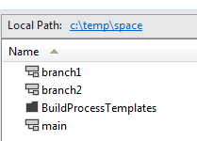
VISUAL STUDIO READINESS TFS Integration Tools - Standard
branch2
branch2
RI
RI
branch1
branch1
B
FI
RI
B
FI
RI
logical tree view
main
main
B
FI
B
FI
“source”
“target”
Paths (in session config)
Active
$/space
Physical (file) view

Slide 38
VISUAL STUDIO READINESS TFS Integration Tools – Merge Scope
branch 2
skip branch and forward integration actions
as they are out of scope
RI
branch 1
branch 1
B
FI
RI
B
FI
RI
logical tree view
main
main
B
FI
B
FI
“source”
“target”
Paths (in session config)
Active
$/space/branch1
Physical (file) view
mergescope = $/space/branch1

Slide 39
VISUAL STUDIO READINESS TFS Integration Tools – Cloak
branch 2
RI
migration conflicts
branch 1
branch 1
RI
B
FI
RI
B
FI
RI
logical tree view
main
main
B
FI
B
FI
“source”
“target”
Paths (in session config)
Active
$/space
Cloaked
$/space/branch2
Physical (file) view

Slide 40
Branching & Merging
Silver bullet

Slide 41

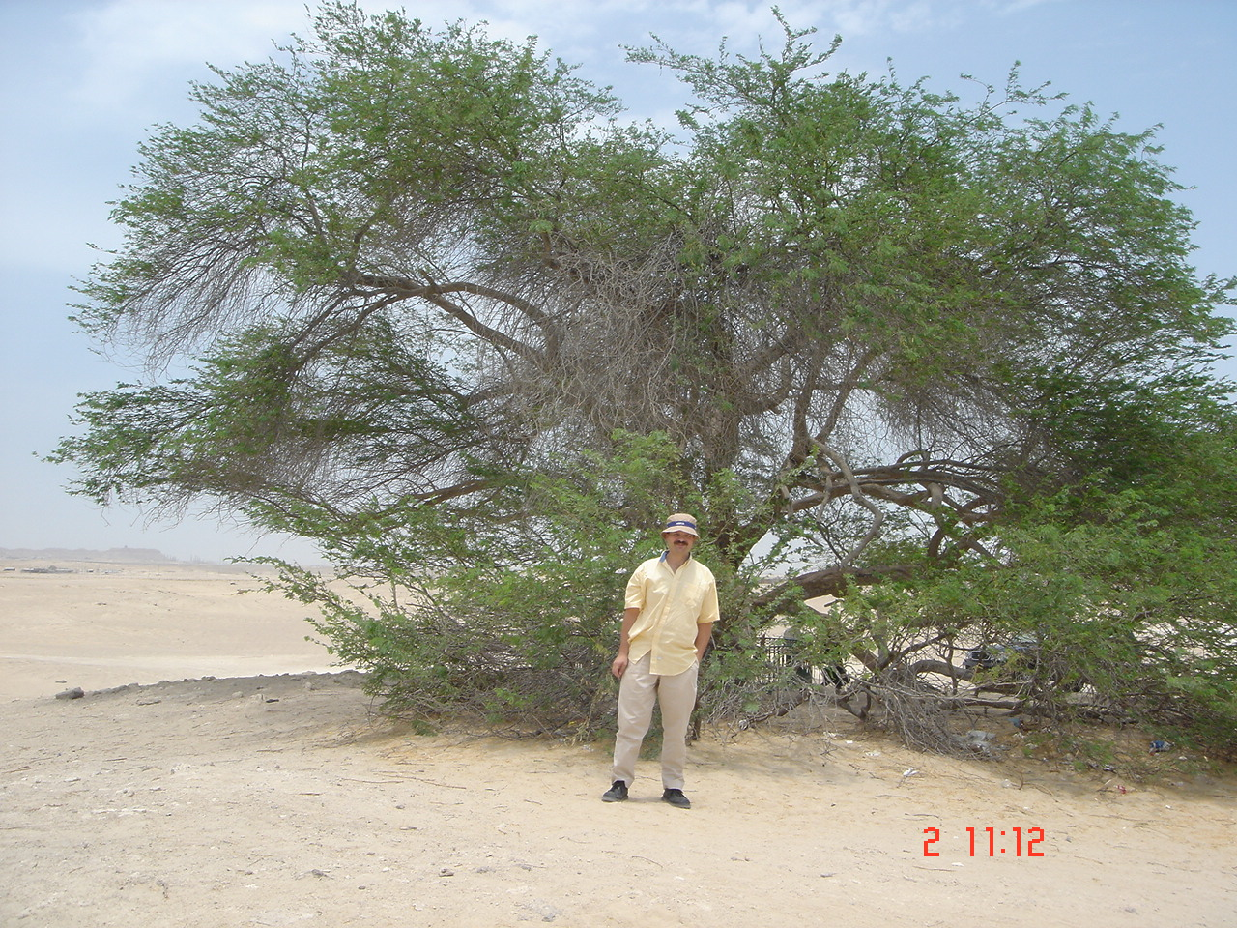

Slide 42

To branch or not to branch … that is our adventure!

Slide 43
VISUAL STUDIO READINESS NuGet Package Structure
\
content
images
nice.png
shared.component
code.cs
lib
net40
shared.component.dll
net45
shared.component.dll
tools
smartscript.ps1

Slide 44


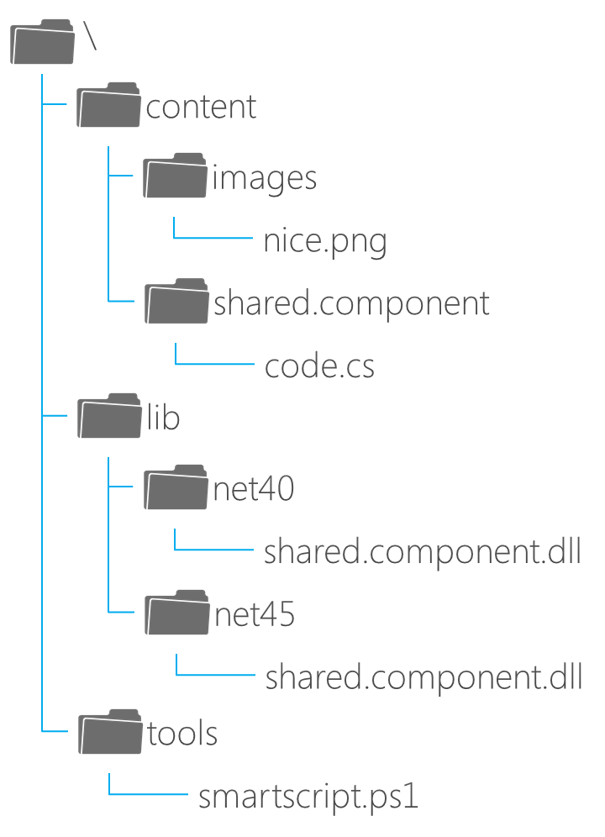
VISUAL STUDIO READINESS NuGet Build Process
.nuspec file
NuGet.exe
.Shared 1.0.0.nupkg
NuGet Repository
VS2012/ Team Build/
NuGet.exe
spec
pack
push
install
update
Local Disk
NuGet Server
Repository
UNC Share
NuGet package source

Slide 45

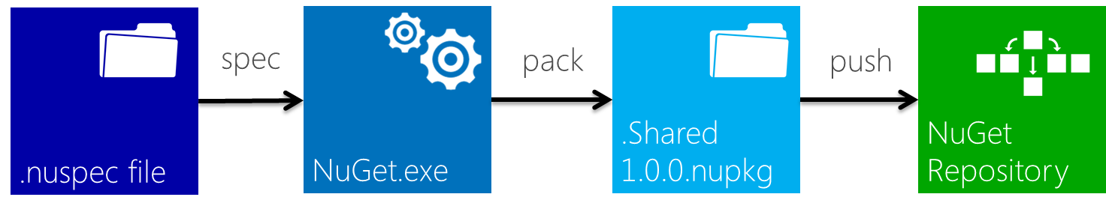
③ Receive notifications and update packages in project
manual process
① Check-in package and changes to TFS Version Control
② Add packages to VS project
Developer
reference resources in VC
Team Foundation Build
.csproj
CONFIGURATION
PRE-BUILD
BUILD
NuGet
❷ Add packages and enable package restore in VS project
❶ Create NuGet Packages
automated process
download automatically
Developer
Local Disk
NuGet Server
Repository
UNC Share
NuGet package source

Slide 46
VISUAL STUDIO READINESS TFVC Folder Structure – By Release
\
Product A
1.0.0.0
Service
Release
1.1.0.0
Service
Release
Current
Dev
Main
Feature
Feature branch

Slide 47
VISUAL STUDIO READINESS TFVC Folder Structure – By Purpose
\
Product A
Release
1.0.0.0 Release
1.1.0.0 Release
Service
1.0.0.0 Service
1.1.0.0 Service
Dev
Main
Feature
Feature branch

Slide 48
VISUAL STUDIO READINESS TFVC Folder Structure - Feature
Feature Name
Src
Exe
Lib
UnitTest
Build
Doc
Test
Tools

Slide 49
VISUAL STUDIO READINESS Walkthrough - Blips
main
B
servicing r1.sp1
B
release 1
B
crisis
RI

Slide 50
VISUAL STUDIO READINESS Development and Release Isolation Simplified
dev
main
B
B
release

Slide 51
VISUAL STUDIO READINESS Servicing and Release Isolation Sample
FEA 1
B
main
B
B
B
SER A
SER B
B
B
B
REL A
REL B1
REL B2
REL_FEA_1

Slide 52
Common User Stories

Slide 53
1. Add Items to Source Control

Slide 54
2. Get Items

Slide 55
3. Check-in

Slide 56
4. Delete

Slide 57
‘optimistic’ push
conflicts!
Workspace
Server Repository
Merge
commit merge changes
pull
Local Repo
Merge
Central Repository
push changes

